Slide 1



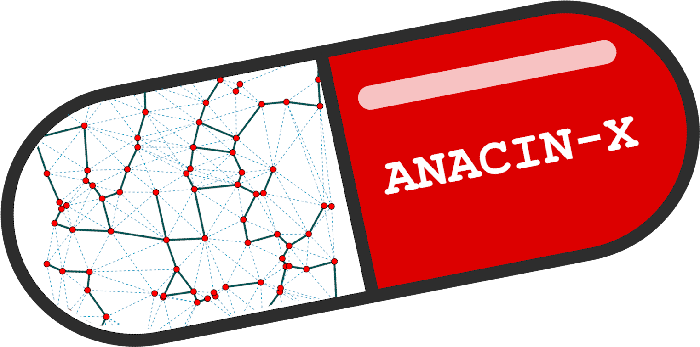


Teaching Non-determinism in High Performance Applications
Jack Marquez, Befikir Bogale, Aashish Pandey, Nigel Tan, Sanjukta Bhowmick, Michela Taufer

Slide 2
Communication Non-Determinism
Example of a simple MPI application and its communication pattern
P₀
P₀
The MPI applications can run on the same computer and yet have different executions (i.e., order in which the messages are exchanged)
MPI process
P₁
P₁
P₂
P₂
Logical order of communication events
This is communication non-determinism.

Slide 3
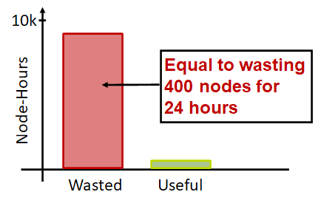
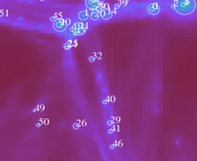
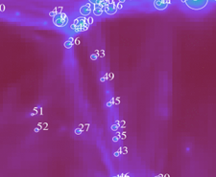
Impacts of Non-Determinism
Expensive Bug: HYPRE [1]
Variable Results: Enzo [2]
HYPRE solves linear systems of equations.
A non-deterministic catastrophic bug occured in only 2% of executions.
Impact:
  18 months of scientists’ time
  9560 node-hours
Enzo detects galactic halos.
Detection of galactic halo 49 is nondeterministic, harming trustworthiness of the result.
[1]. Sato, K., Ahn, D.H., Laguna, I., Lee, G.L., Schulz, M. and Chambreau, C.M., 2017, January. Noise injection techniques to expose subtle and unintended message races. In ACM SIGPLAN Notices (Vol. 52, No. 8, pp. 89-101). ACM.
[2]. Stodden, V. and Krafczyk, M.S., 2018. Assessing Reproducibility: An Astrophysical Example of Computational Uncertainty in the HPC Context

Slide 4
Motivation
We present key components for a tutorial module to introduce computer science students to the concept in non-determinism.
The tutorial module is currently in development.
We seek feedback on ways to use the material in class and conferences.

Slide 5
Overview of Tutorial Module
MPI application components:
Platform
Input Parameters
Source Code
Communication patterns
Tutorial module components:
Beginner Level: | Visualize non-determinism in different communication patterns
Intermediate Level: | Measure non-determinism associated to different input parameters
Advanced Level: | Identify the root sources of non-determinism in different runs

Slide 6
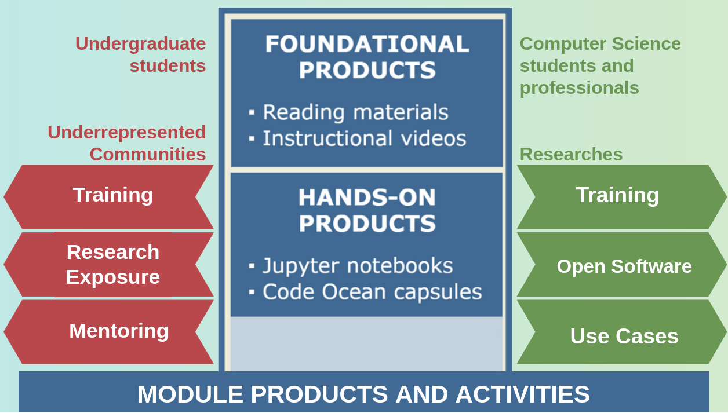
Software and Platforms
MPI Mini-Applications
Apptainer Container

Slide 7
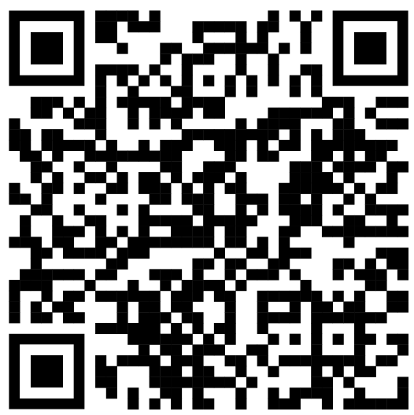
Opportunities for Collaborations
The tutorial module presented introduces students to three levels of understanding in non-determinism:
Visualize non-determinism
Measure impact of parameters on application non-determinism
Identify root causes of non-determinism
We are looking for collaborations
Information we should add to this tutorial module
Additional mini-applications for students to study in this tutorial module
More information at https://globalcomputing.group/anacin-x/

