Slide 1
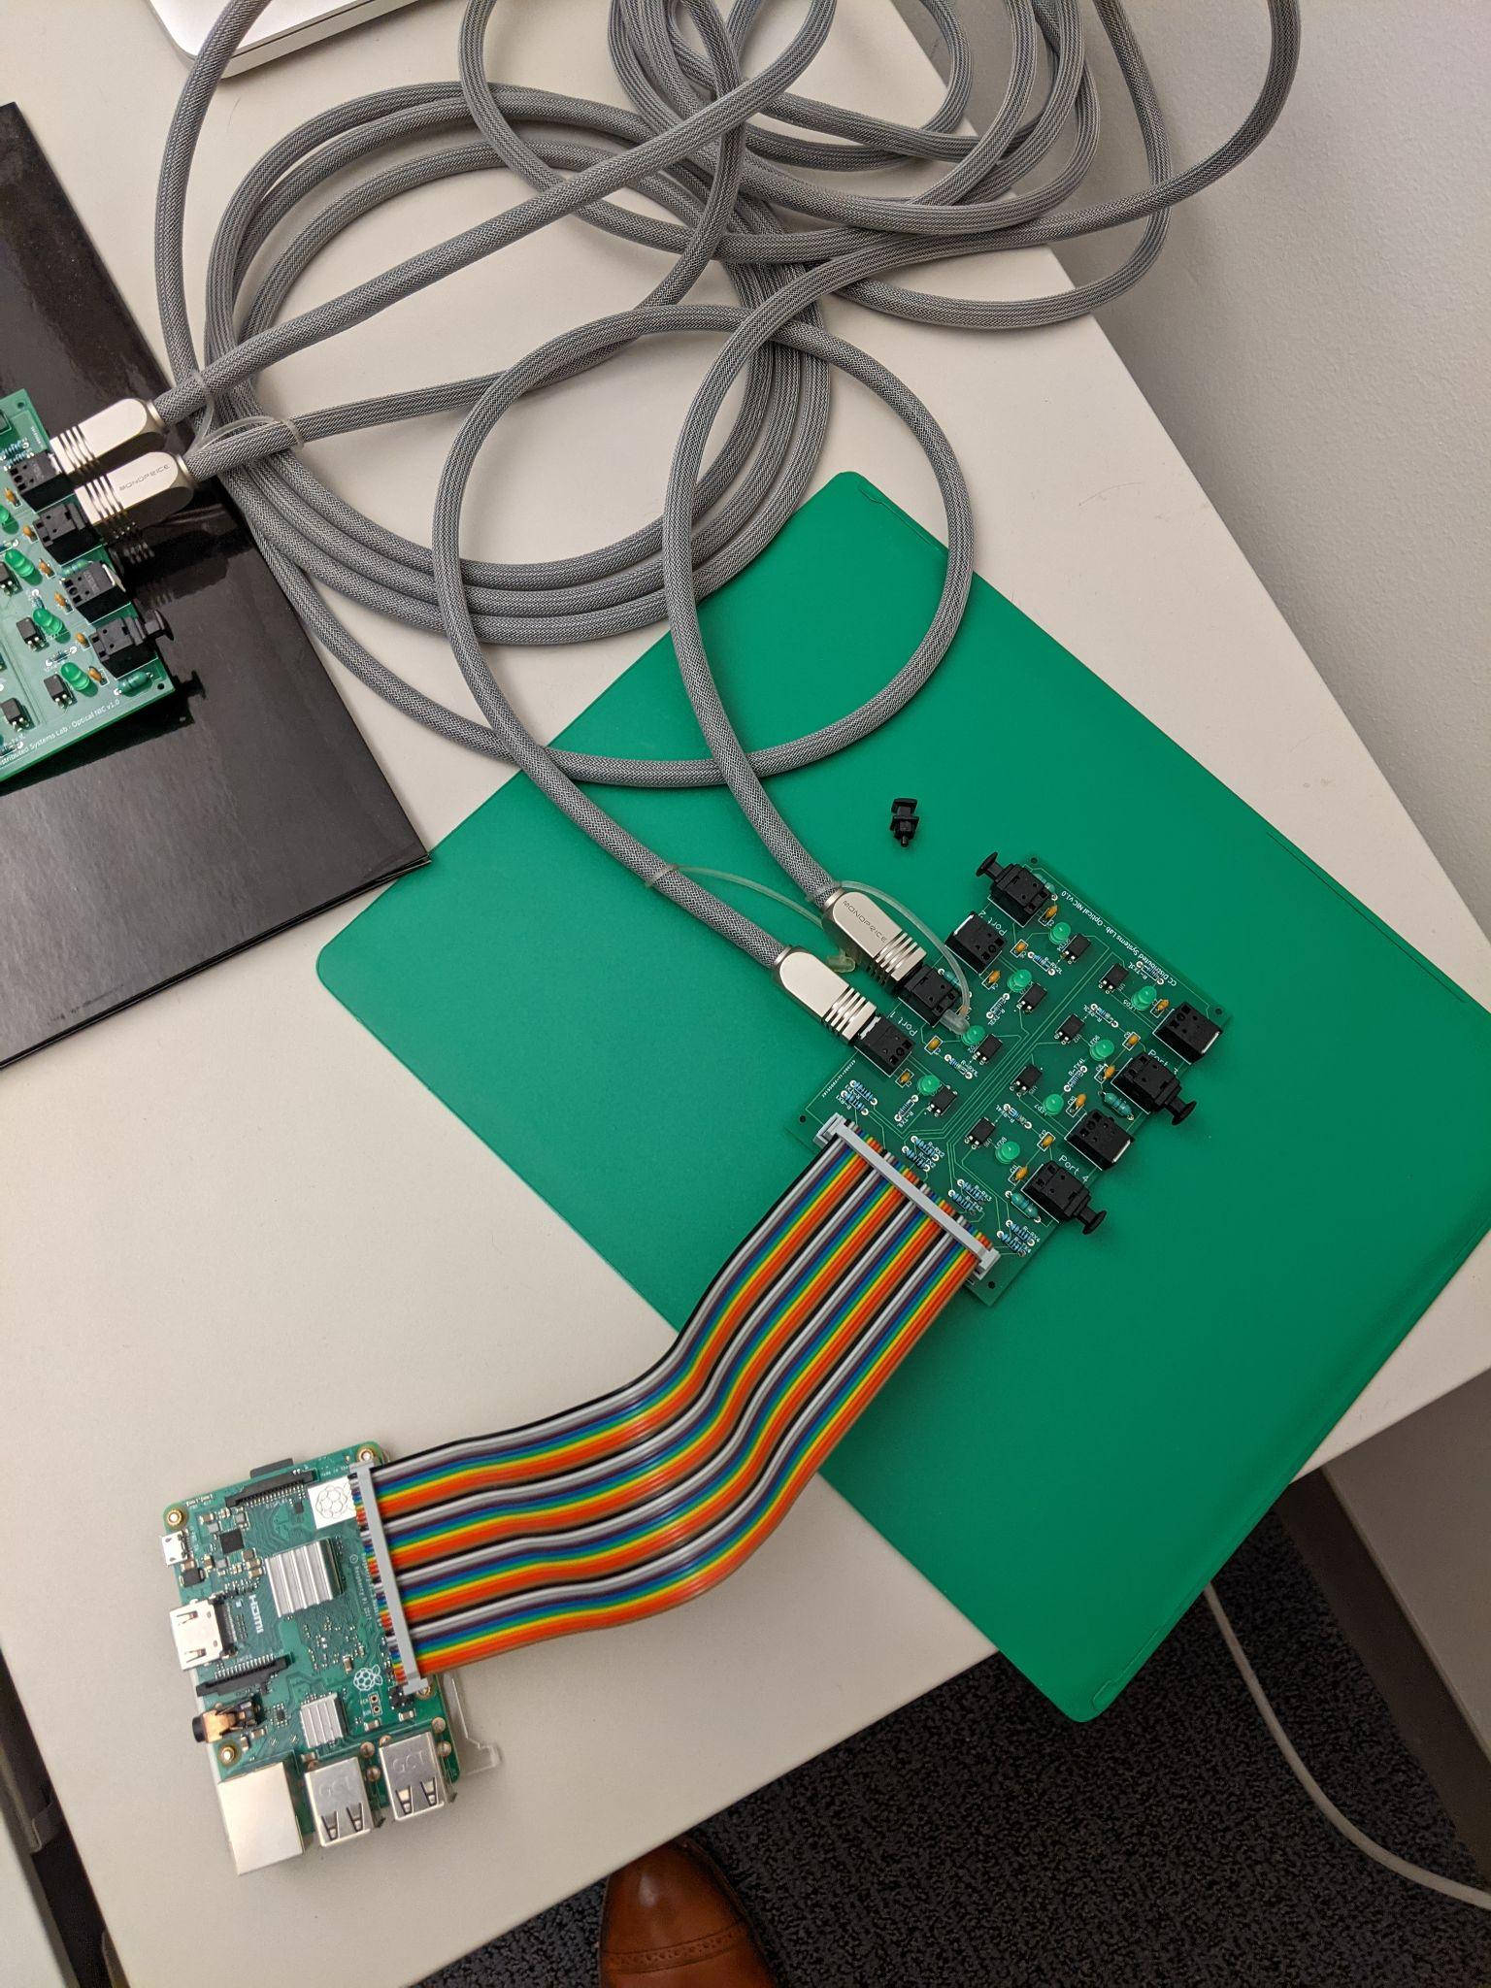

The World’s Worst Optical NIC
“I felt like we put a lot of work into only getting 475bps” - Course eval
Danielle Ellsworth
dellsworth@coloradocollege.edu

